Slide 1
Airshare
Project done by- Sai Nadkarni
Rohan Menon
Neelansh Prasad
Shiv Tomar

Slide 2
Idea
->Create an app to facilitate wireless file transfer between an android device(phones,tablets) and a PC.
->Transfer is bidirectional i.e User can send as well as retrieve files seamlessly between PC and device.
->Uses a LAN(Local Area Network) connection to connect the devices and does not rely on the Internet,just need to be connected to the same network.

Slide 3
The ‘WHY’ behind it
->Making full use of the amenities available as a college student with access to 100Mbps+ LAN internet campus-wide.
->Eliminating tedious USB file transfers or involvement of the internet to email important documents or practicals done in lab.
->USB cables tend to get lost,this is a permanent solution to the problem.
->The technical challenge based in implementing this idea.

Slide 4
Implementation
->Android app has a startup page which runs a IP check in background at app startup,determines the IP and displays for user to enter in PC browser.
->Upon entering IP, user gets a confirmation dialog about connection request.
->Confirming opens up a UI on PC browser with access to device’s storage.
->User has freedom to upload data in any folder,same goes for downloading data.
->Android app maintains the connection in background with no other input necessary.

Slide 5
Implementation(advanced)
->App is only useful if there is no need of the internet,where services like dropbox,google drive etc exist.
->A connection has to be made using only LAN,which is accomplished using a PAW web server.
->A PAW server essentially allows us to use the functionality of our phones from a web browser.
->Aforementioned PAW server is completely free to use and with source code available,thanks to the open source nature of Android.

Slide 6
Implementation(advanced)
->A web page needs to be developed using HTML,to showcase a UI for user to interact with on browser.
->This web page is accessible on browser as soon as the PAW server is enabled and user confirms the connection request.
->Web Page to be made using HTML5,Javascript and CSS.
->Android’s WiFi modules and media scanner are made use of.

Slide 7
Userbase
->People who have access to a fast local area connection.
->LAN is established everywhere; in offices,colleges,malls,hotels etc.
->No need of internet access,just need connection to router to facilitate data transfer wirelessly.
->Diminishes the use of a USB cable just for the express purpose of data transfer,which is cumbersome as it requires installation of drivers etc depending on device to device.

Slide 8
Design
->App itself has minimal UI,everything is based on webpage.
->Confirmation dialog,basic IP display text box and a connection acknowledgement screen is all that is needed.
->Web Page requires HTML formatting with optional CSS implementation for a polished UI.
->Implement Google’s Material Design to develop app interface.

Slide 9
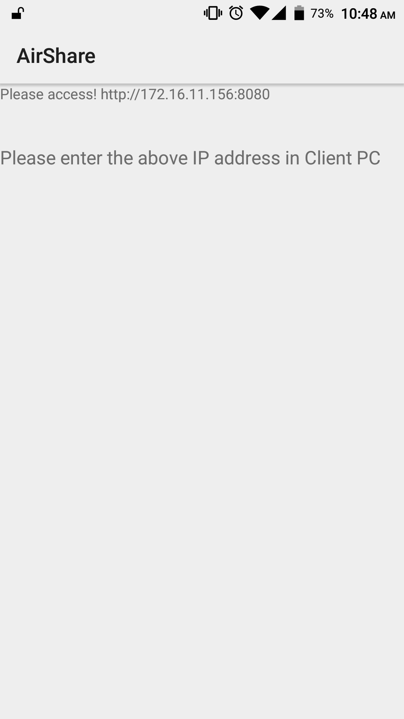

Slide 10
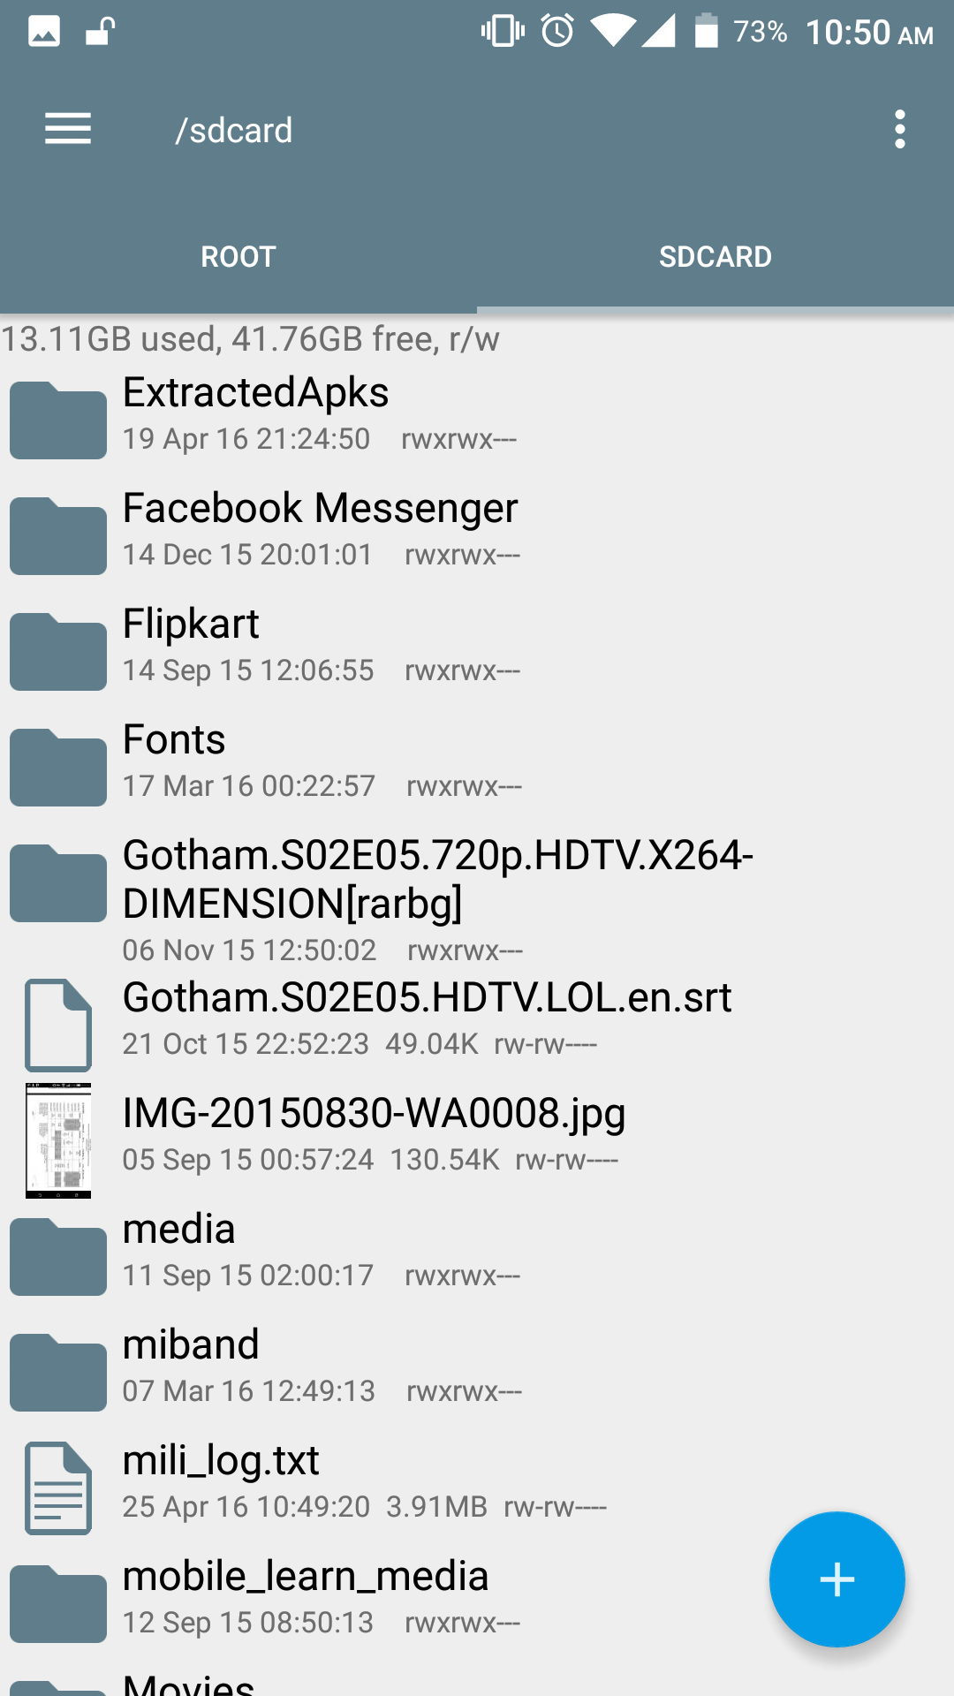

Slide 11
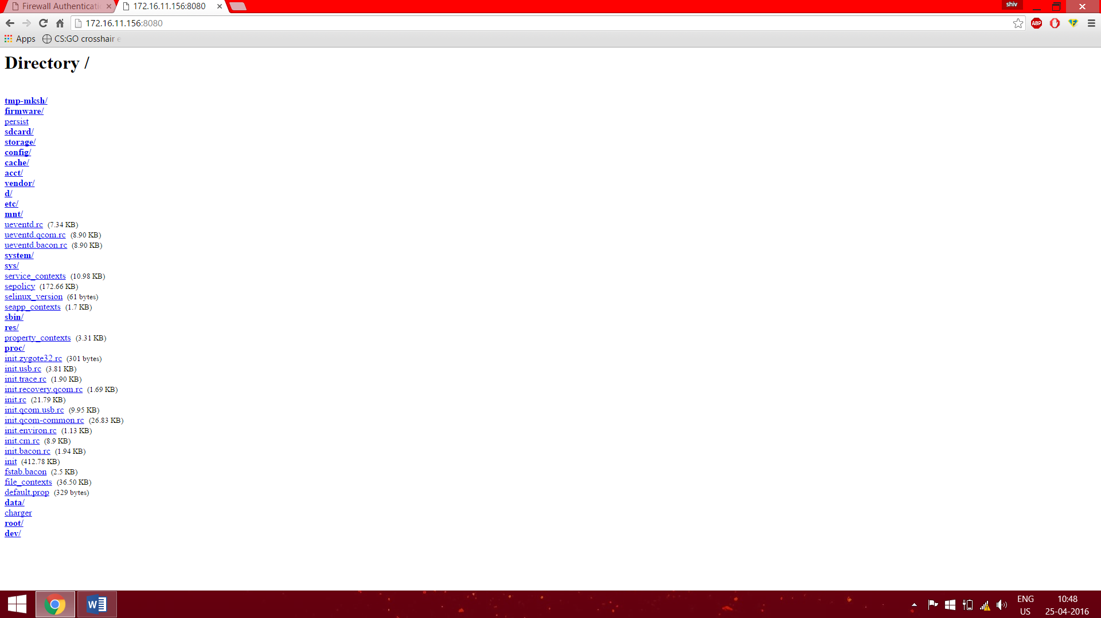

Slide 12
Scope
->The same implementation and features can be used to make a file transfer app between 2 Android devices,using WiFi of both devices where one is host device creating the local web server and other device connects to it using WiFi. Note that this implementation DOES NOT need an external LAN as both devices are WiFi equipped and can communicate with each other thanks to Android’s WiFi direct.
->FTP server needs to be made to negate the need of a LAN connection in current app,which is not a simple solution and needs user technical know-how.

Slide 13
Thank You.

